Slide 1
The Underclassmen’s Guide to…E-mail Etiquette
Freshman/Sophomore Advisory
2013-2014

Slide 2
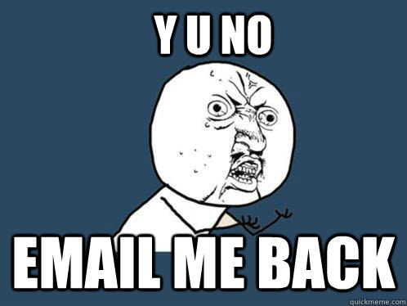
Why E-Mail?
BHS is centered around technology
E-Mail is a quick and easy-to-use tool for remaining in contact with teachers and staying up-to-date on important BHS and classroom information
Yet…getting students to even check e-mail is like pulling teeth!

Slide 3
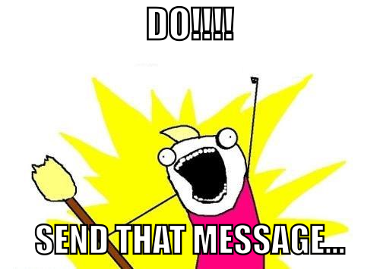
When to E-Mail?
With a partner, talk about the reasons you would need to e-mail a teacher or another student.
Share!

Slide 4
How to E-mail: The Bad
Teacher,
I turned in that one assignment but u gave me a 0. ARE YOU GOING TO FIX THIS?
Or
I don’t know what to do about our assignment. I don’t understand it.
Or
I’ve been busy with [insert other stuff] and haven’t had time to do it or look at it. Can I turn it in late?

Slide 5
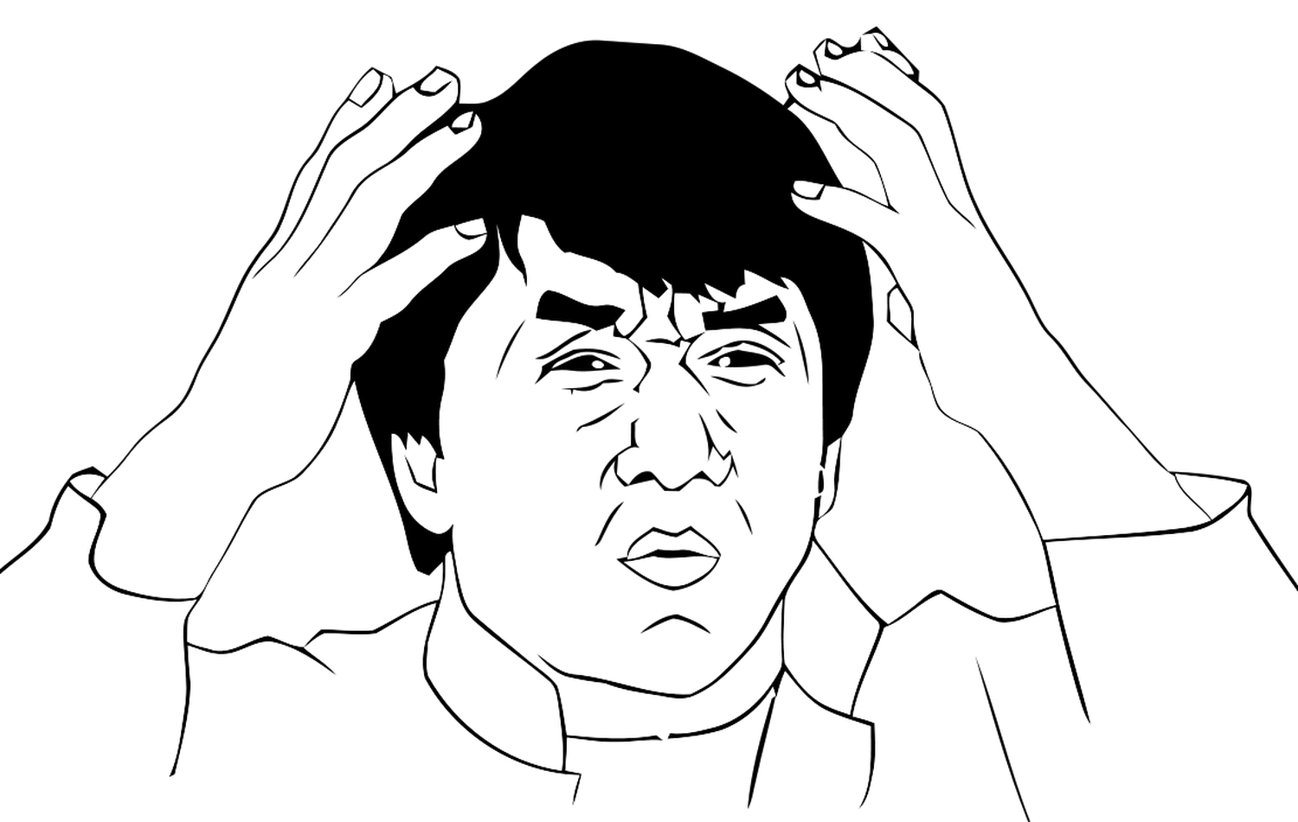
How would you make these emails better?
With your partner, pick one email and re-write it.
Share with class!

Slide 6
What NOT to do…
Start with “Hey” or “Teacher”
Be vague in any kind of way (ex. That one assignment)
TYPE IN ALL CAPS…YOU DON’T LIKE TO BE YELLED AT AND NEITHER DO WE!
Make excuses for not completing your work…other activities (even school related) do not get you extra time.
FORGET TO INCLUDE YOUR NAME

Slide 7
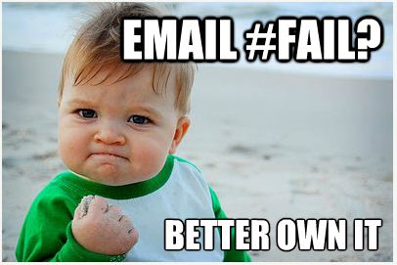
Hey…we all make mistakes.

Slide 8
What to DO in an e-mail
Address you teacher by their name
Include your name (either at beginning or at end of email)
State the issue/concern you are having clearly-be as specific as possible!
Ask for help from teacher in fixing the issue
End with “Thank you”
Sign your name (first & last) at the bottom
Include block (1A, 1B, etc.)

Slide 9
The Good
Ms./Mr. [insert last name here]
I checked on home access last night and saw that I have a 0 for our Get To Know You Handout. I believe I turned that in on time last week when it was due. I want to make sure because I do not want to lose the points for the assignment. Would you check again? I will stop by before school tomorrow to check in with you. Thank you.
Firstname Lastname (1A)

Slide 10
REMINDER: E-mails are a professional form of communication, school is your profession. Make it a habit to check your e-mail every day!
Once you accomplish this…

