Slide 1
Monday January 12, 2014
Warm Up: Write down the following questions on a Notability page:
Who is Elena Kagan replacing?
What are Elena Kagan’s qualifications?
What did her parent’s do for a living?

Slide 2
Today’s Objective
To summarize AUTHORITY AND ROLE of the Supreme Court

Slide 3
VIDEO

Slide 4
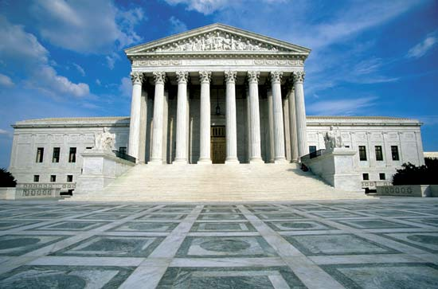
UNITED STATES SUPREME COURT JUDGES

Slide 5
Foundations of U.S. Law: VOCABULARY
Society must believe that laws are fair and apply equally to everyone.
English Common Law: collection of court cases and customs on which their laws are based
Case Law rules and regulations that courts developed in their decisions. Serve as PRECEDENTS for future cases.

Slide 6
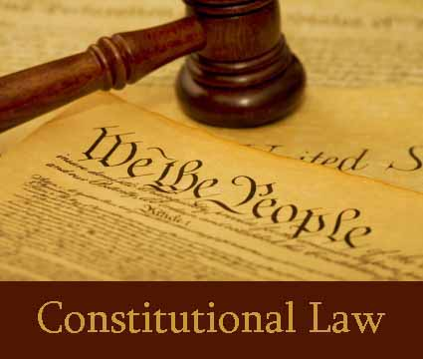
Constitutional Law: Federal law must abide by Constitution. State laws cannot violate U.S. Constitution

Slide 7
Jurisdiction and Structure of the courts
Jurisdiction: Authority of a court to hear a case.
The facts of the case determine which court has jurisdiction over a case.
Original Jurisdiction Hears the case first.
Exclusive Jurisdiction: absolute authority over a case.

Slide 8
Concurrent Jurisdiction: More than one court has jurisdiction over a case. Faces charges in both courts.
Example: Oklahoma City Bombing.
Terry Nichols and Timothy McVeigh were tried in a state court for first degree murder charges. That is a state crime.
They were also tried in a federal Court for using weapons of mass destruction on a Federal Building.
.

Slide 9
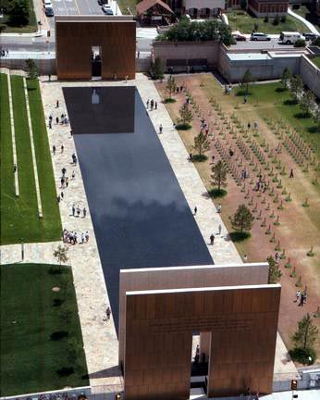

Slide 10
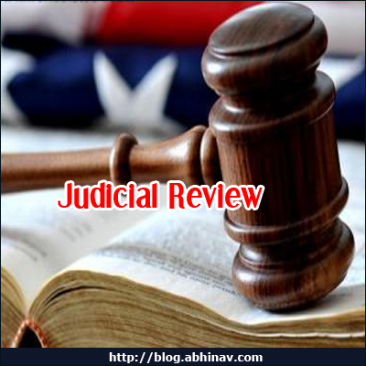
Roles of the Supreme Court
Their primary power is called Judicial Review.
Judicial Review: allows court to declare acts of congress, the president, or states unconstitutional.

Slide 11
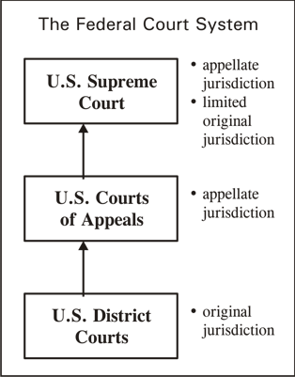
Appellate Jurisdiction:
Courts hear cases on appeal.

Slide 12
Workings of the Supreme Court
Hears only a fraction of cases. AVERAGE 150 PER YEAR
Writ of Certiorari: request records of the case from the lower courts. They issue one when they want to resolve a pressing constitutional question.

Slide 13
Procedures
See procedures text on website and my Homework

Slide 14
Define Writ of Certiorari and how did
the U.S. Supreme Court use it in the
Missouri V. McNeely case.

Slide 15
OPINIONS!!!
Unanimous opinion: All judges agree for the same reasons.
Majority opinion: A Justice from the majority writes decision of the court and explains the reasons for its decisions.

Slide 16
Concurring Opinion: Written by Justice who agrees with majority opinion but for different reasons.
Dessenting Opinion: Written by a Justice who disagrees with majority and explains reasons .
The opinions and vote go on record.

Slide 17
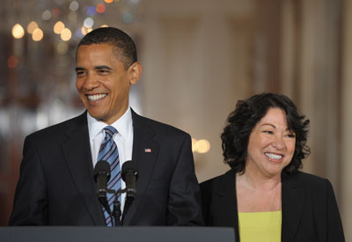
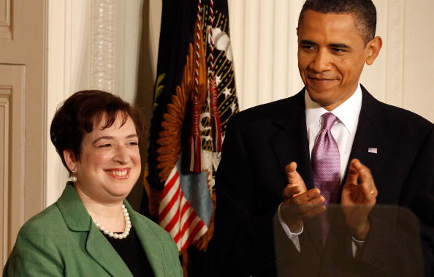
EXECUTIVE BRANCH APPOINTS SUPREME COURT JUDGES. Congress approves appointments
Sonia Sotomayor
Elena Kagan

